Slide 1
Regularization : Bias and Variance,L2 Reqularization

Slide 2
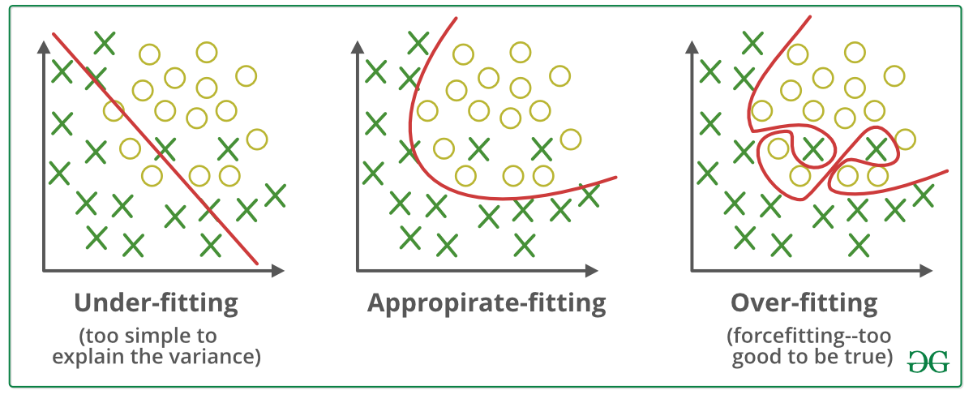

Slide 3
Bias and Variance
By looking at the algorithm’s error on the training set(which we call bias) and on the dev set(which we call variance) we can try different things to improve the algorithm
What is bias?
Bias is the difference between the average prediction of our model and the correct value which we are trying to predict. Model with high bias pays very little attention to the training data and oversimplifies the model. It always leads to high error on training and test data.
What is variance?
Variance is the variability of model prediction for a given data point or a value which tells us spread of our data. Model with high variance pays a lot of attention to training data and does not generalize on the data which it hasn’t seen before. As a result, such models perform very well on training data but has high error rates on test data.

Slide 4
How to address high Bias ?
Bigger network ie more hidden layers or more hidden units.
Train it longer.
Try some more advanced optimization algorithms/better NN architecture

Slide 5
How to address high variance(aka overfitting) ?
Add more data
Regularization
Search for a better NN architecture

Slide 6
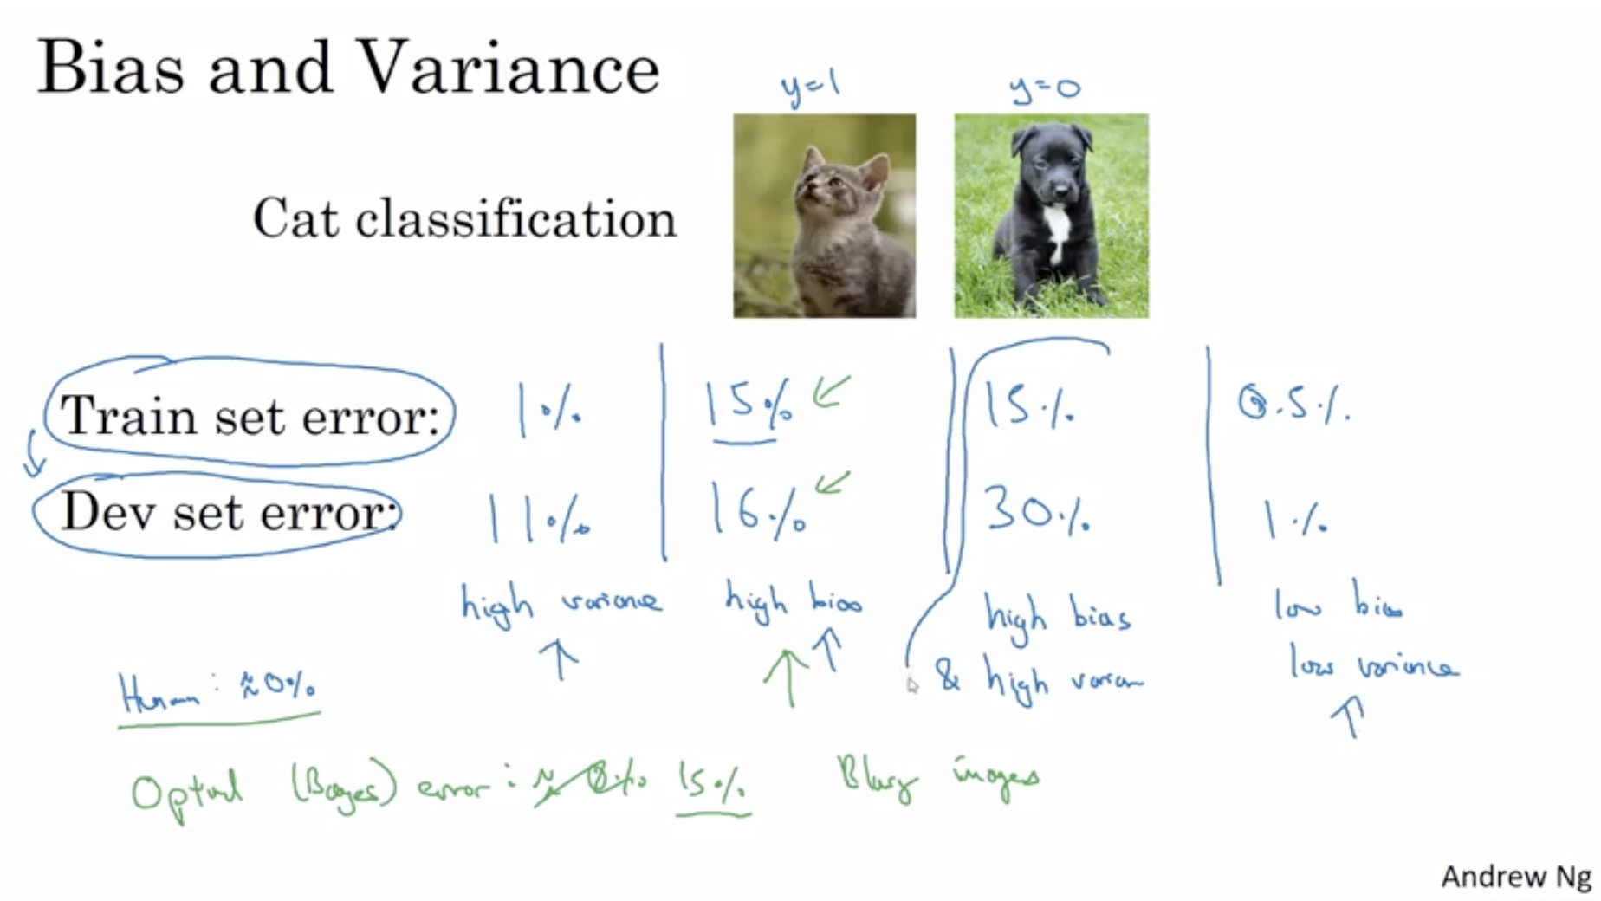
Example

Slide 7
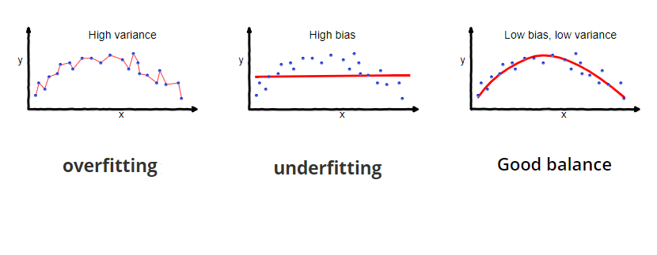

Slide 8
Why is Bias Variance Tradeoff?
If our model is too simple and has very few parameters then it may have high bias and low variance. On the other hand if our model has large number of parameters then it’s going to have high variance and low bias. So we need to find the right/good balance without overfitting and underfitting the data.
This tradeoff in complexity is why there is a tradeoff between bias and variance. An algorithm can’t be more complex and less complex at the same time.

Slide 9
Total Error
To build a good model, we need to find a good balance between bias and variance such that it minimizes the total error.

Slide 10
Mathematically
Let the variable we are trying to predict as Y and other covariates as X. We assume there is a relationship between the two such that
Y=f(X) + e
Where e is the error term and it’s normally distributed with a mean of 0.
We will make a model f^(X) of f(X) using linear regression or any other modeling technique.
So the expected squared error at a point x is

Slide 11
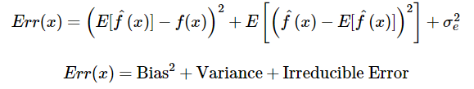
The Err(x) can be further decomposed as
Err(x) is the sum of Bias², variance and the irreducible error.
Irreducible error is the error that can’t be reduced by creating good models. It is a measure of the amount of noise in our data. Here it is important to understand that no matter how good we make our model, our data will have certain amount of noise or irreducible error that can not be removed.

Slide 12
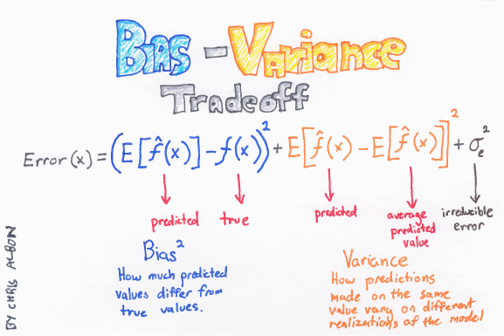

Slide 13
Regularization
The word regularize means to make things regular or acceptable. Regularizations are techniques used to reduce the error by fitting a function appropriately on the given training set and avoid overfitting.
Regularization is a set of techniques that can prevent overfitting in neural networks and thus improve the accuracy of a Deep Learning model when facing completely new data from the problem domain.

Slide 14
Regularization
Regularization is a technique used to reduce the errors by fitting the function appropriately on the given training set and avoid overfitting. The commonly used regularization techniques are :
L1 regularization
L2 regularization
Dropout regularization

